Slide 1

Key Performance Indicators
Max Mustermann, xx.xx.xxxx

Slide 2

Agenda
the road to meaningful KPIs
1
Key Performance Indicator 1.0
5
Key Performance Indicator 2.0
2
Key Performance Indicator 1.1
6
The Bigger Picture
3
Requirements
7
Next Steps
4
Showcases

Slide 3
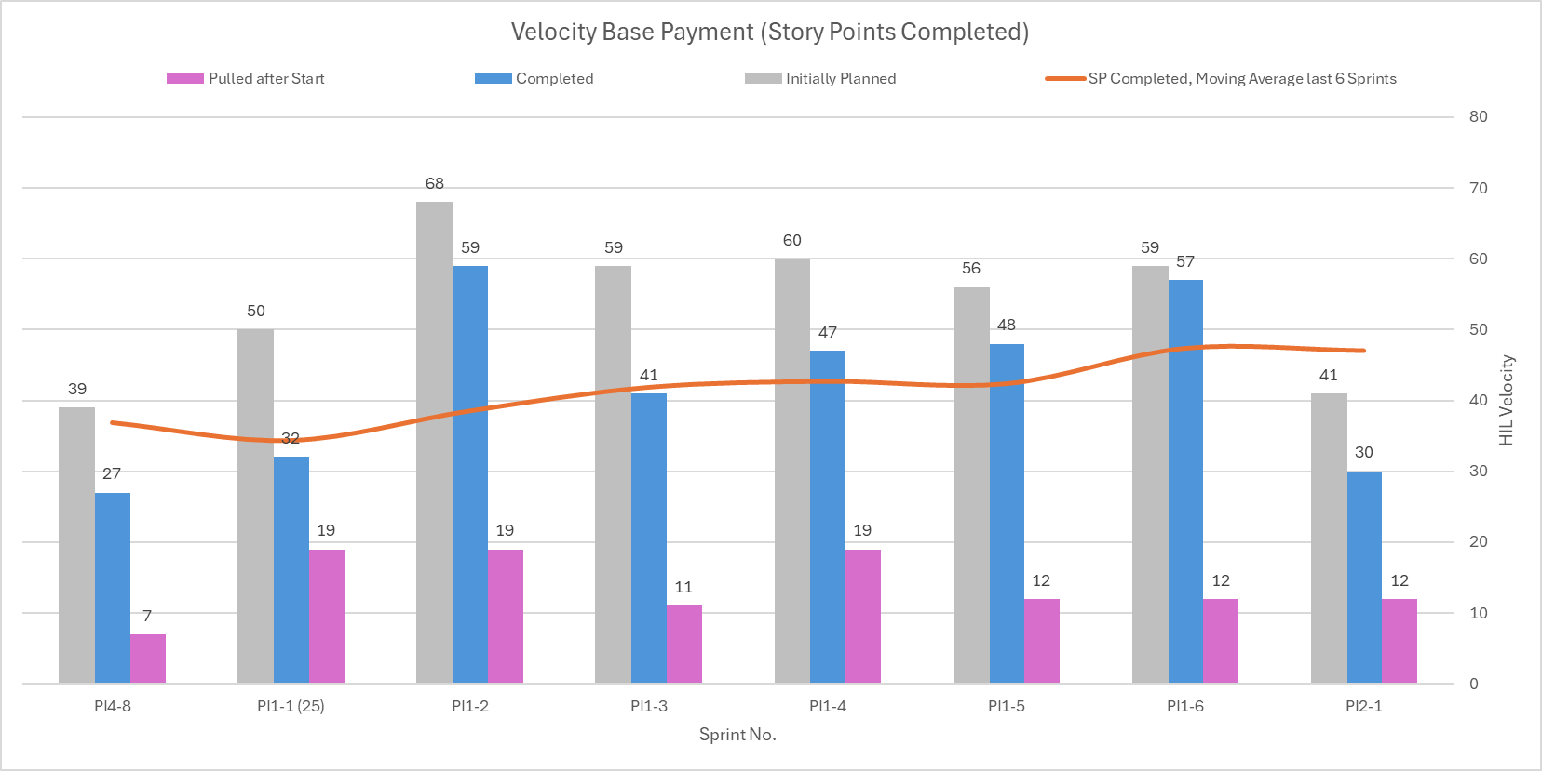
Key Performance Indicator 1.0
current reporting, basically straight from Jira
those are way lower in reality
those are lower in reality
seemingly over-committed
accounting in
spill-overs
repeatedly
is this good or bad?
what does this tell us?
Notes:
HIL Hieratic, Incremental, Librating
Raw data from Jira: Completed sums up closed tickets only and Initially Planned fully sums up spill-overs everytime they are part of the sprint

Slide 4
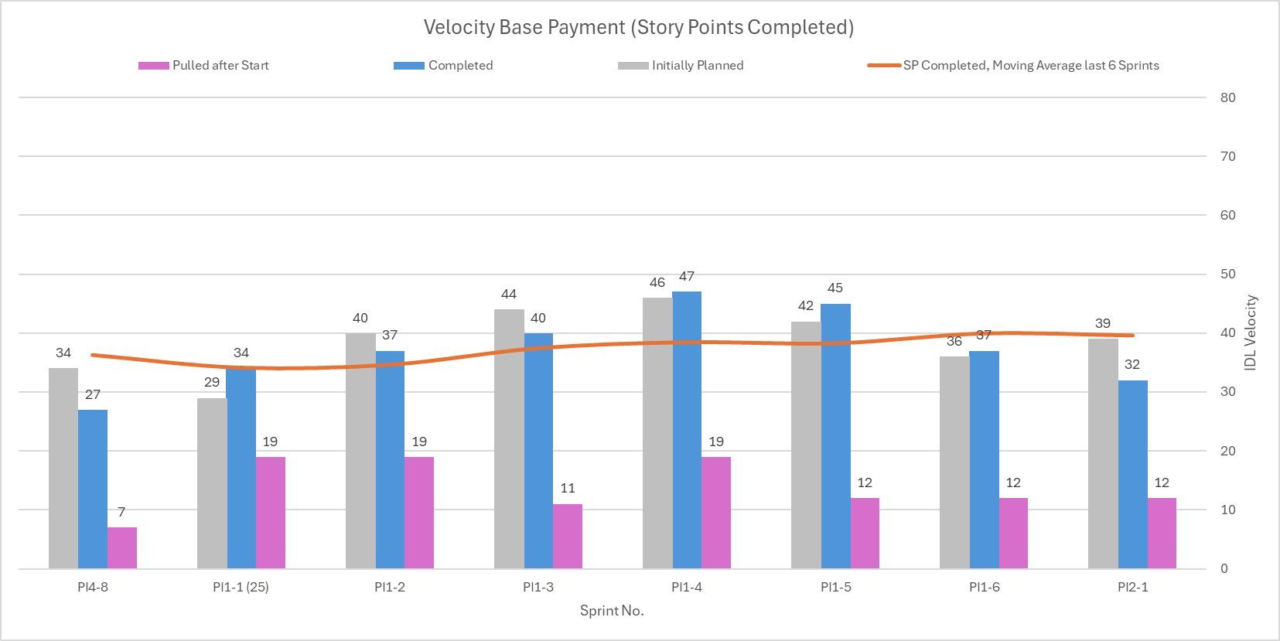
Key Performance Indicator 1.1
merely taking spill-overs into consideration
flattened,
but virtually
the same shape
still slightly over-committed,
but not notoriously
heights are now realistic
Notes:
IDL Interleaved, Differentiating, Levelled
Complexity sums of planned and finished tickets consider spilled-over values (=smoother) and carried-over values (=lower)

Slide 5
Requirements
KPI need to be based on information that has relevance in real-life processes and is easily obtainable
KPI need to address clearly defined questions
“Did the team perform well?”
“Was the sprint plan achievable?”
KPI definitions should include predetermined interpretations
KPI values need to be comprehensible and traceable
Visualisation of KPI needs to provide all information needed for interpretation
Visualisation of KPI should be simple and tidy

Slide 6
Showcases
“Was the sprint plan achievable?” → „How realistic was the plan?“
Initially Planned vs. Average Velocity
„How strictly are we adhering to the original scope?“
Initially Planned vs. TrueScope [= Initially Planned + Pulled after Start – Removed from Sprint]
„How well are we conforming with the overall trend?“
Velocity vs. Linear Projection

Slide 7
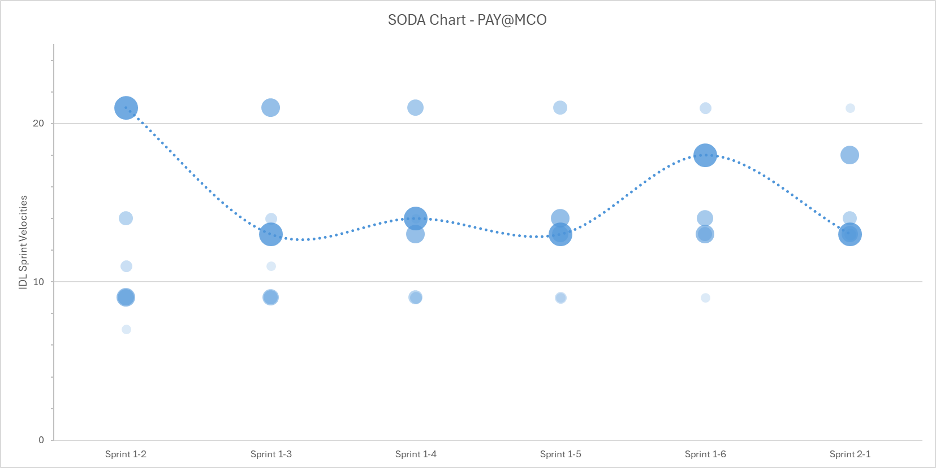
Showcase: the SODA Chart
look mum, no numbers!
same value, gradually disappearing
sprint value
(respectively)
current
sprint
Notes:
SODA Stacked & Ordered Development-Accomplished

Slide 8
Key Performance Indicator 2.0
“Did the team perform well?”
Information
Story complexities [= absolute storypoints]
Spill-over values [= unfinished storypoints] and carry-over values [= remaining storypoints]
Calculations
Accomplished storypoints [≠ closed absolute storypoints]
Average velocities (from finished storypoints)
Standard deviations (from finished storypoints)
Visualisation
Current velocity (as sum of accomplished storypoints)
Average velocity
Rating zones (defined by average velocities and standard deviations)
Average velocity -2x standard deviation … +2x standard deviation
Interpretations spanning from values that are too good to be true, over values that facilitate a high and sustainable output, down to values that are abysmally low

Slide 9
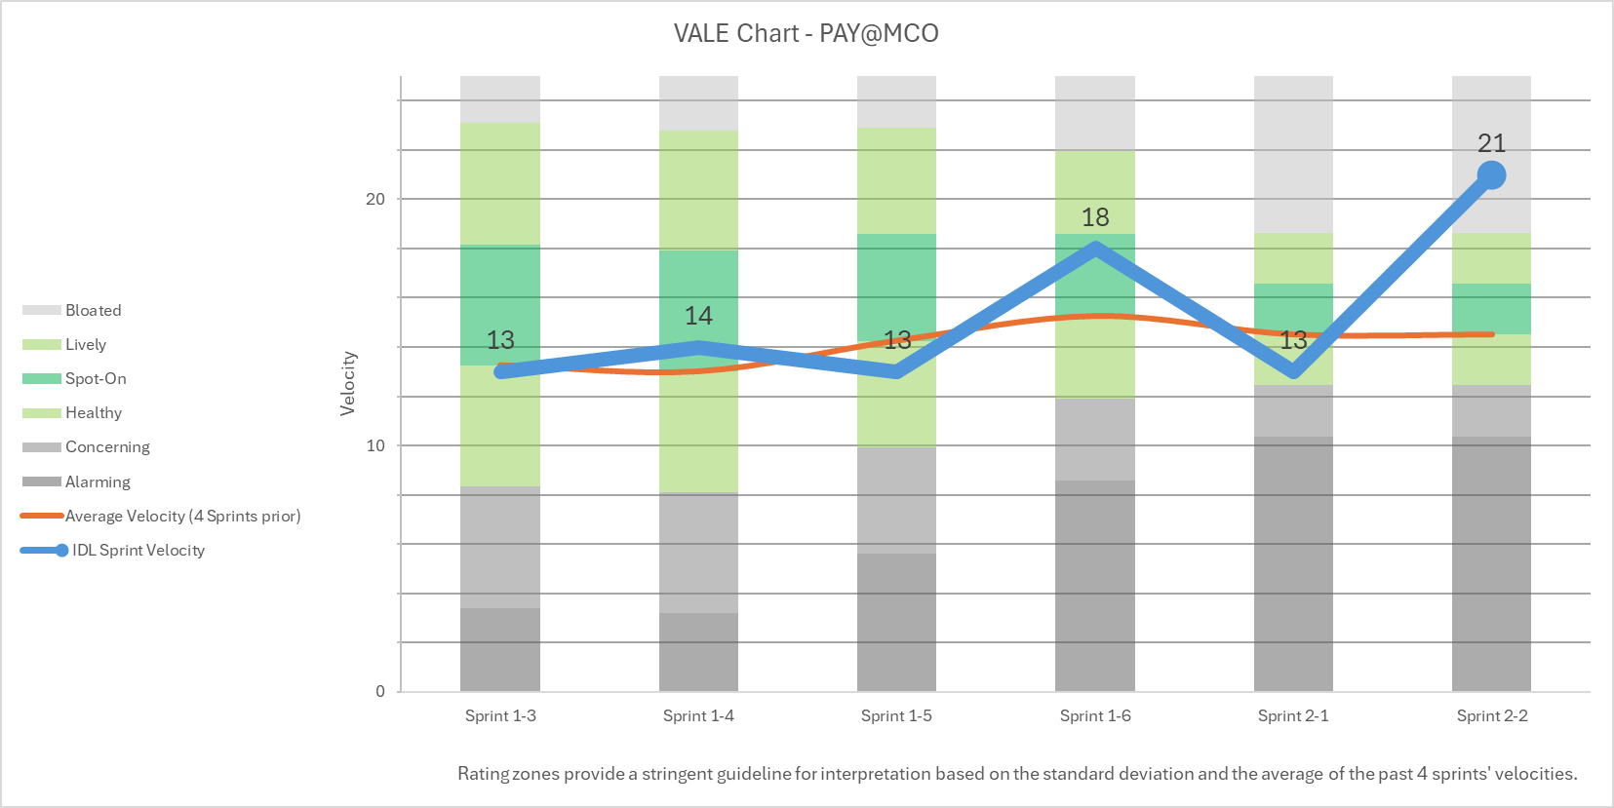
Key Performance Indicator 2.0: the VALE Chart
it‘s all about context
shrinking fluctuation, tightening tolerance
current
Sprint
Rating zones
Bloated ^{AV+2SD…∞} A significant share of this exceedingly high output probably comes from other effects than team performance alone
Analysis is advised because possibly there's something to be learned
Lively ^{AV+1SD…+2SD} The team's performance was outstanding, pushing the envelope on the brink of an unsustainable pace
Spot-on ^{AV…AV+1SD} The team performed very well while also managing to increase the stability of their long-term output
Healthy ^{AV-1SD…AV} Things cannot always go up, so going down within the team's usual range of performance is perfectly normal
Concerning ^{AV-2SD…-1SD} Something went considerably wrong, but we're still seeing a robust core performance
Analysis is needed and also some learning that may result in adjustments
Alarming ^{0…AV-2SD} The major share of this plummeting output was probably caused by factors beyond the team‘s influence
Thorough analysis is needed which will lead to profound learning and change
Notes:
IDL Interleaved, Differentiating, Levelled
VALE Velocity Attribution with Logical Explanations

Slide 10
The Bigger Picture
Story Maps
„How is Team performance?“
„How is Epic progress?“
Sprint
KPI
Epic Report
95SR Velocity
Rating Zones
Forecast
Analysis → Learning
→ Adjustment/Change
Decisions & Actions

Slide 11
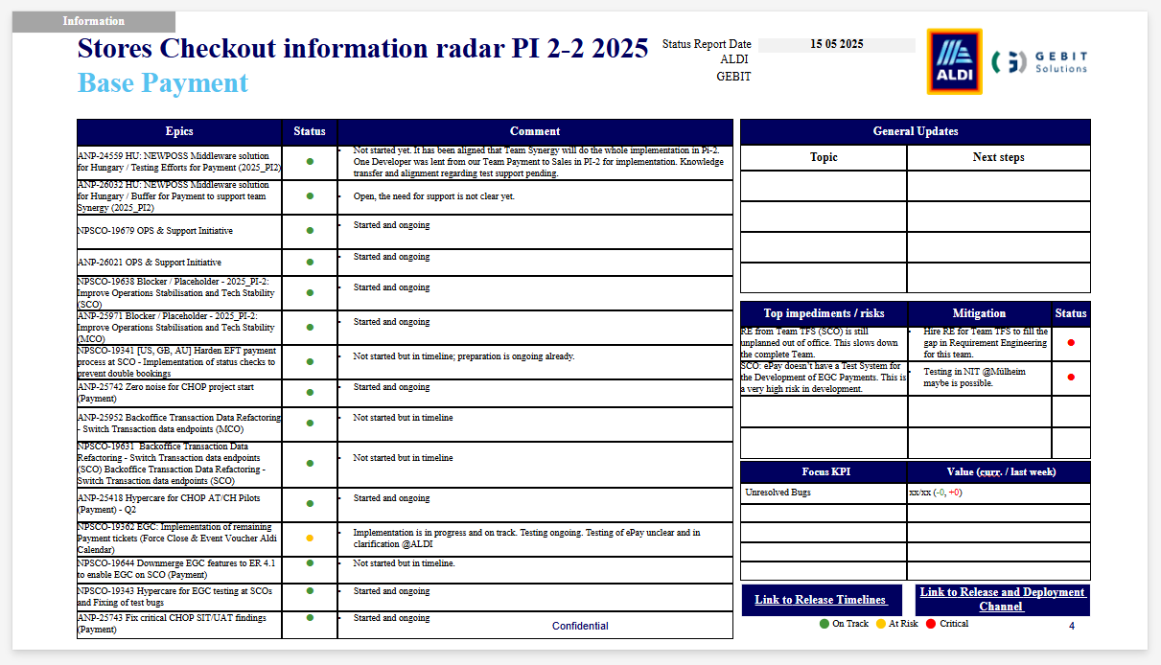
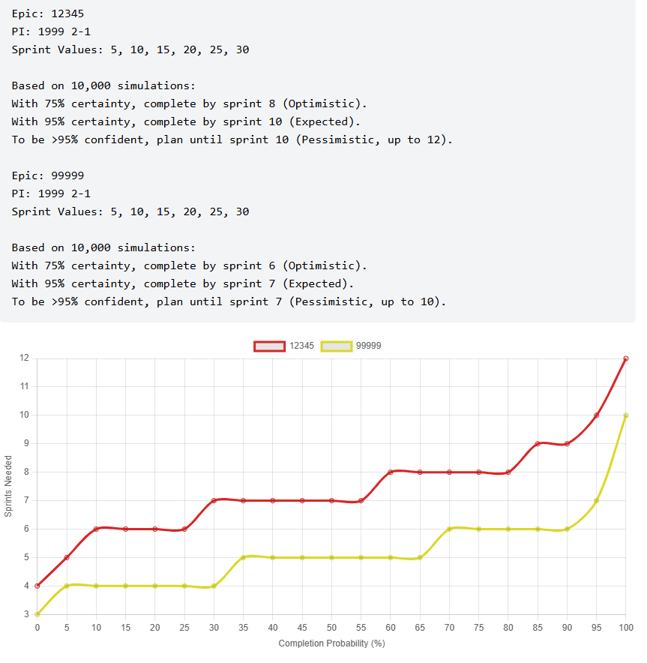
Next Steps
Data Driven Forecasts – from gut to good
Current State
Manual, Unprecise Forecasting
Based on rough estimates
No data-driven validation
Low predictability
Future State
Data Driven Forecasting
Based on historical team & epic velocities
Uses Monte Carlo Simulation
Updated Storymapping approach

Slide 12
Next Steps
Data Driven Forecasts
Transition (in progress)
Analyze current report structure & weaknesses
Explore alternative visualizations
Question and redesign status reporting
Adapt Monte Carlo simulation with epic specific allocation to enable better forecasting
Further improve User-friendliness for Monte Carlo simulation
Target state
Data-driven forecasts integrated in reports
Epic-level capacity predictions
Transparent risk/blocker reporting
Enable forecast-based resource reallocation

Slide 13
Backup

Slide 14
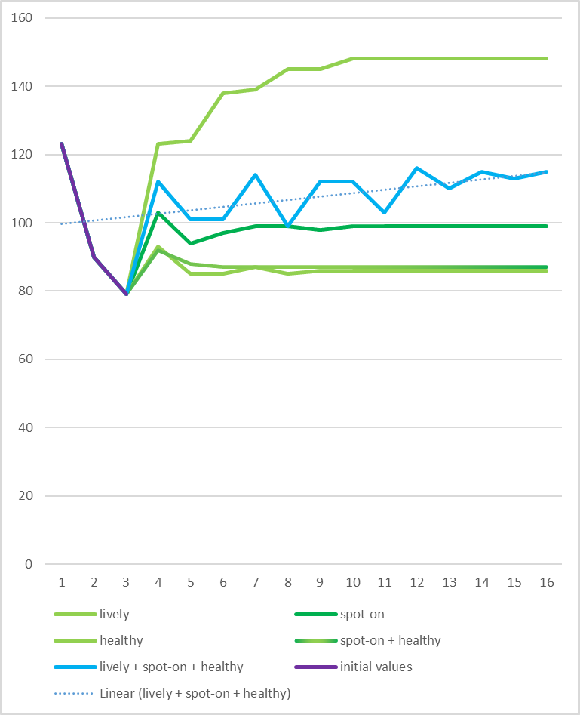
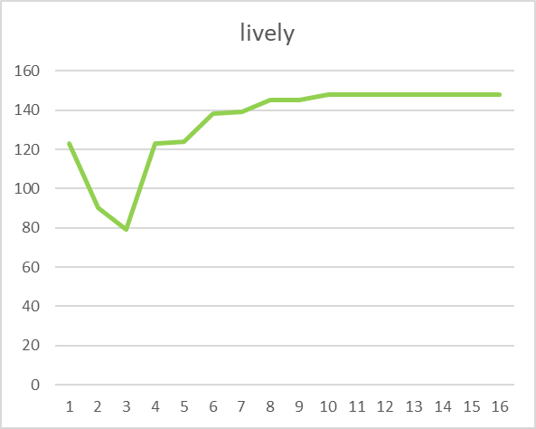
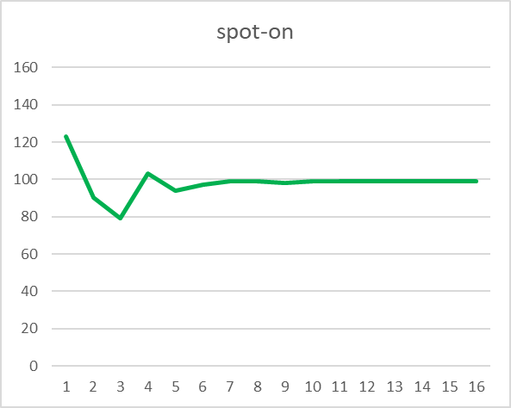
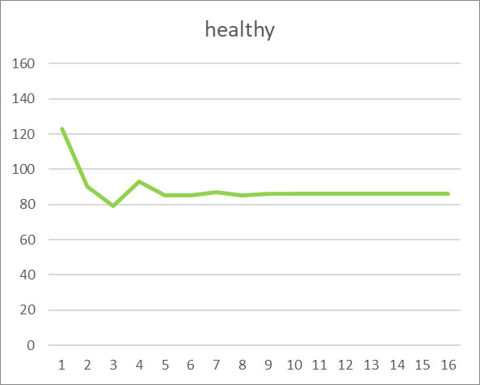
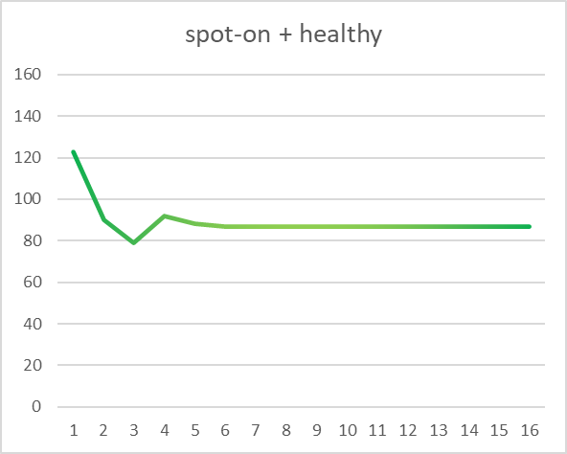
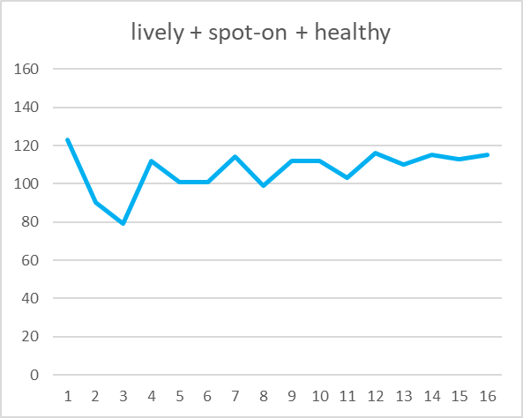
Why „Lively“?
let’s not punish a team for their high stability
If it were considered desirable to never exceed a team‘s usual velocity range
…then a team staying in the rating zones Spot-on and Healthy
…would quickly get unachievably narrow zones
…thus having KPIs worse than one would expect
To remedy this deterioration we need to expand the definition of what‘s desirable

Slide 15
Showcases
“Was the sprint plan achievable?” → „How realistic was the plan?“
Initially Planned vs. Average Velocity
„How strictly are we adhering to the original scope?“
Initially Planned vs. TrueScope [= Initially Planned + Pulled after Start – Removed from Sprint]
„How well are we conforming with the overall trend?“
Velocity vs. Linear Projection

Slide 16
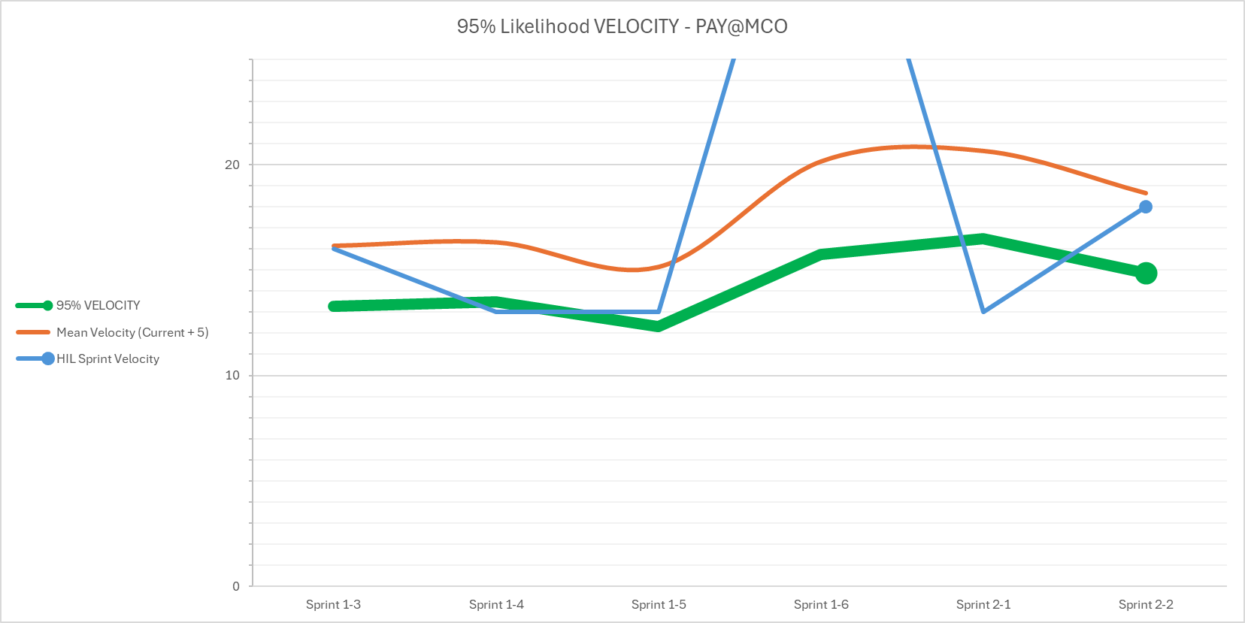
Key Planning Information
“mean” means mediocre expectancy of achieving the nominal
use the mean velocity
to have a 50:50 chance
for your plan to succeed
use this for 95% success rate*
*markdown empirically derived from Monte Carlo simulations of a PI composed of 6 sprints whose velocities are largely determined by the mean velocity and varied within the standard deviation
Notes:
HIL Hieratic, Incremental, Librating
In this case we need the coarseness and the rigour of the HIL values (it doesn‘t matter how much work we can do, what matters is how we digest the chunks we are fed)

